Slide 1
Automated Gaze Coding for Infant Videos
Xincheng Tan, Peng Cao
Notes:
Hello, everyone! We are excited to present our project on automated gaze coding for infant videos.

Slide 2

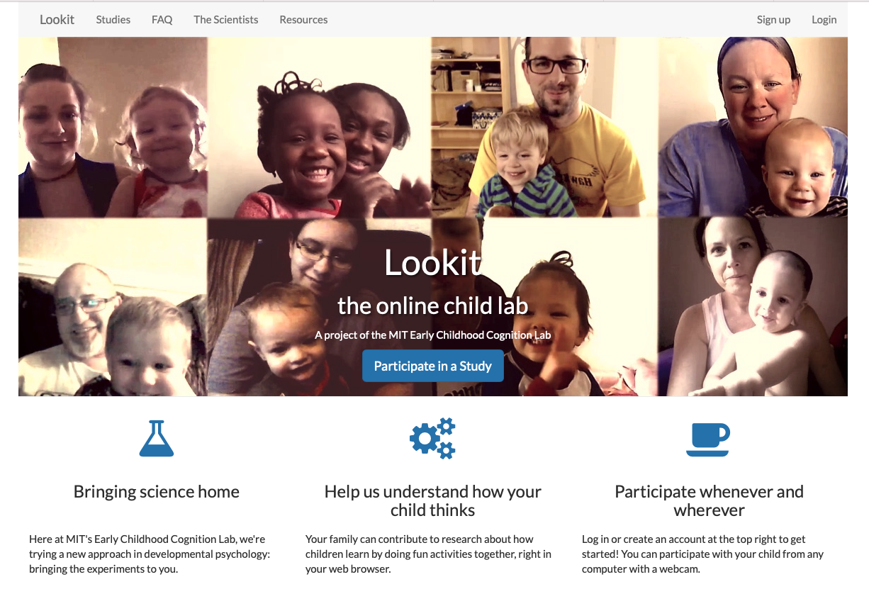



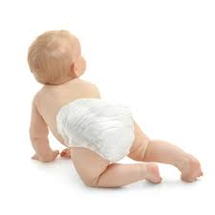
Motivation
Preferential Looking Paradigm
Lookit Online Platform
Notes:
Gaze-based studies are widely used in developmental science for preverbal infants.
For example, to test whether an infant can perceive the auditory-visual relationship,
one can show two clips side-by-side on a screen while playing the sound for one of them.
If the infant looks longer at the clip projected in sound, it means it perceives that relationship.
In this project, we want to help MIT researchers with the Lookit platform that allows families to participate in this kind of study online via webcam.
Its major block is to determine whether the infant is looking at left or right side of the screen based on the recorded video.
It takes a human annotator up to five times as long as the video itself to do gaze coding, so this is not scalable.

Slide 3
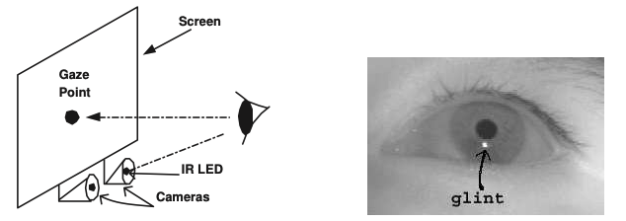
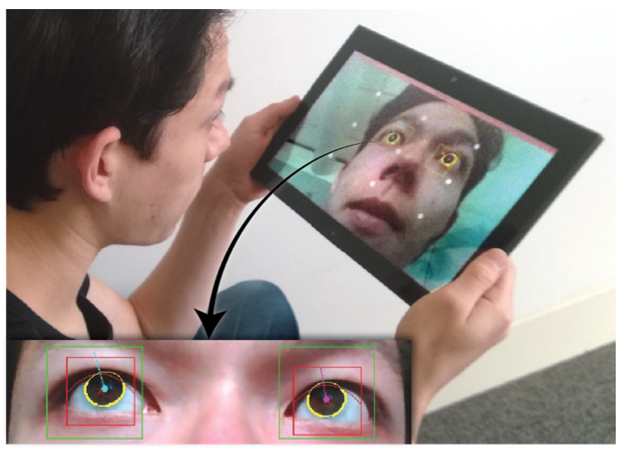
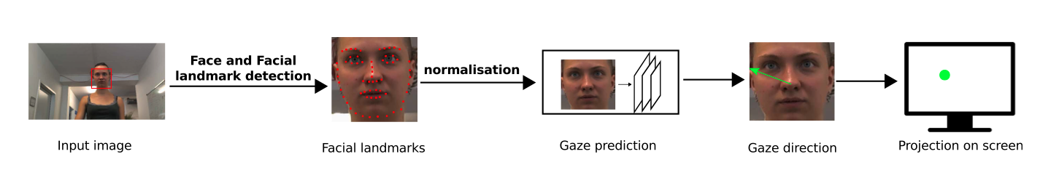
Related work: three categories
Requires additional hardware!
Requires high video quality!
Requires fine-grained annotations!
Feature-based (Zhu et al., 2005)
Model-based
(EyeTab, Wood & Bulling, 2014)
Appearance-based
(OpenGaze, Zhang et al., 2019)
Notes:
Although the state-of-the-art methods can automate gaze estimation with high accuracy,
the feature-based and model-based methods require either additional hardwares or high video quality.
While some appearance-based methods that use deep learning are more promising,
most of them require fine-grained annotations.
So, none of them are suitable for the Lookit data.

Slide 4
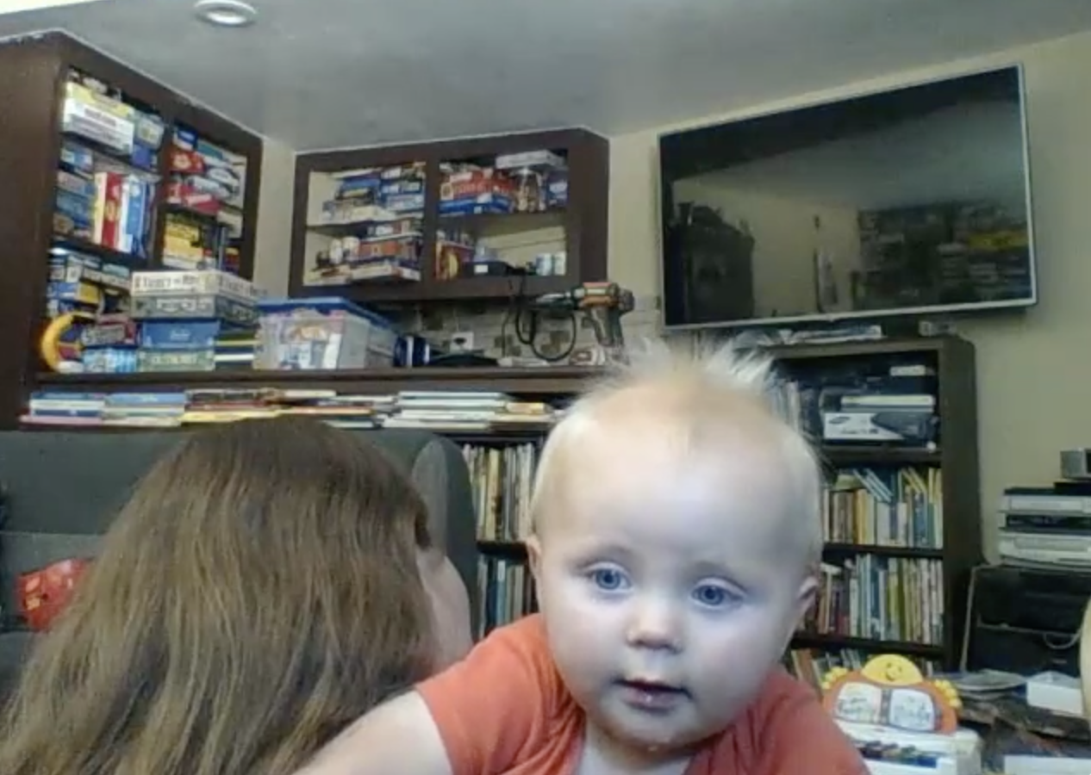
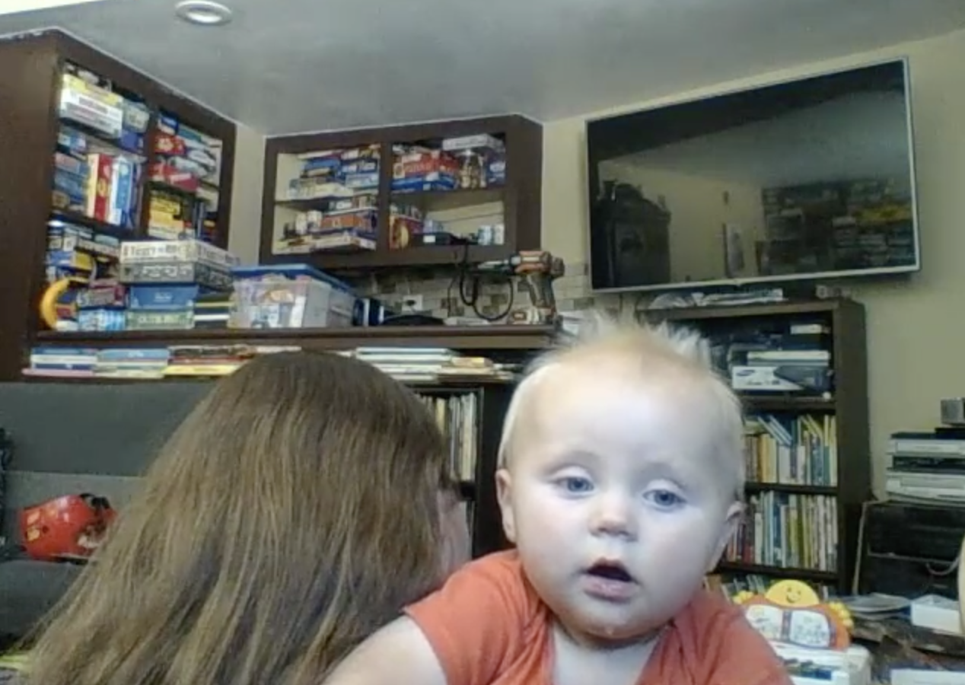
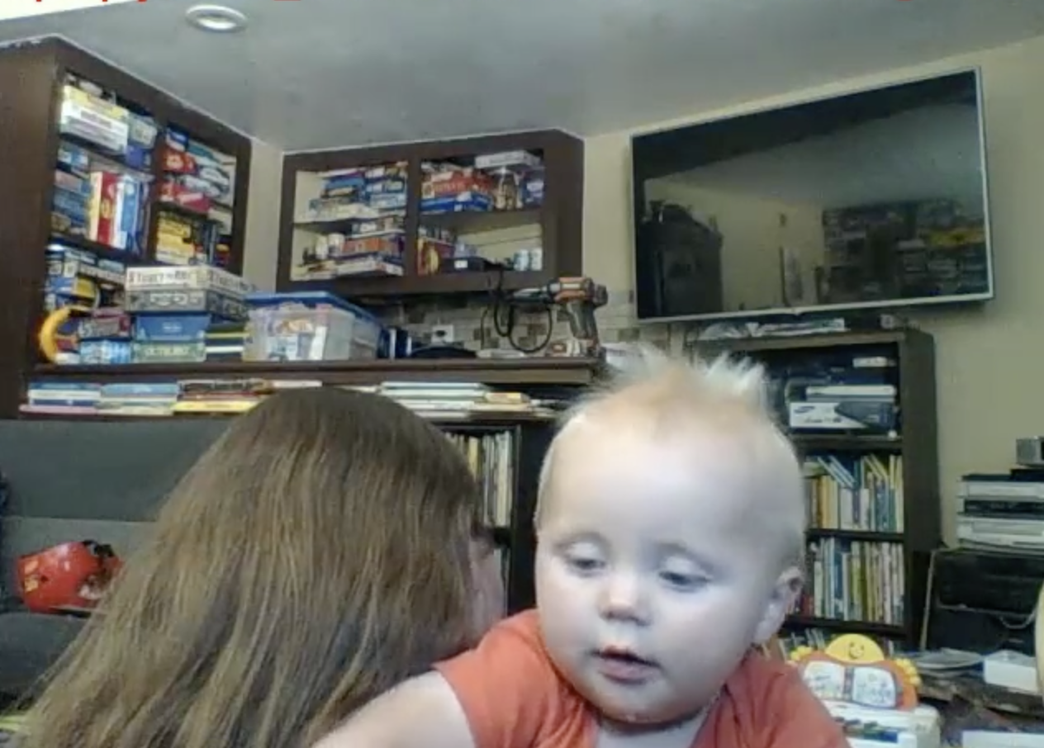
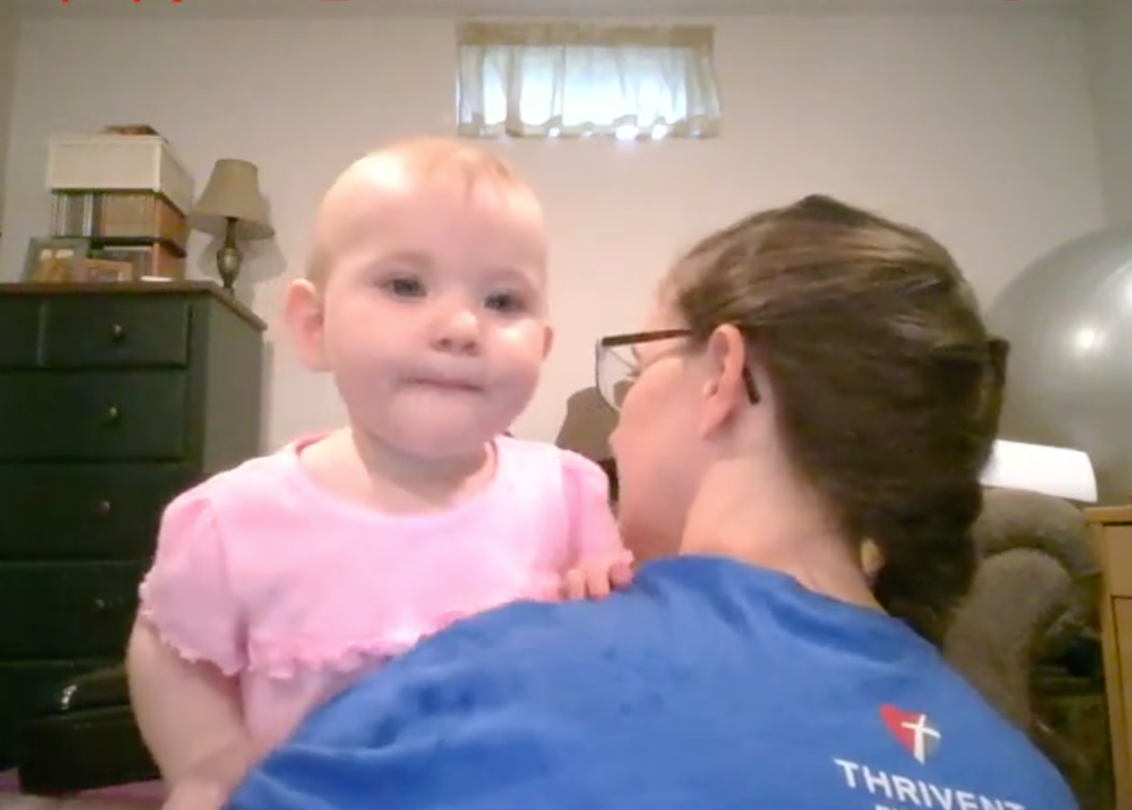
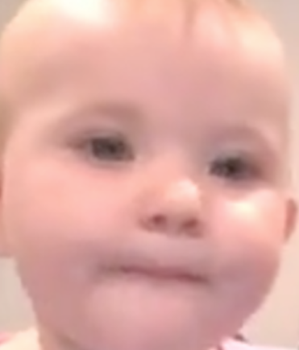
iCatcher (Erel et al., 2020)
Left
Right
Away
Pipeline:
Face Extractor
Gaze
Estimator
Away / Left / Right
Gaze Direction Label
Video Frame
Selected Image Patch
Bounding Box’s Features
Notes:
In the preferential looking diagram, we care about only three gaze directions: left, right and away,
so we look into a simpler appearance-based framework called iCatcher.
It first extracts facial patches, and then uses a deep model to classify the gaze direction.

Slide 5
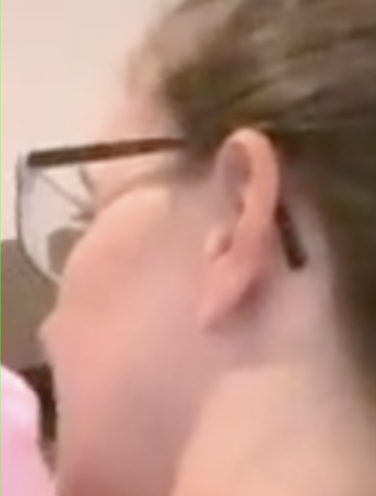
iCatcher
Wrong patch
Error!
Face Extractor
Lowest
Face
Gaze
Estimator
Away / Left / Right
Gaze Direction Label
Video Frame
Extracted Faces
Selected Image Patch
Loss of
positional information
Notes:
However, iCatcher has two main problems.
First, when the face extractor finds multiple faces, it assumes the lowest one is the baby’s face.
But if the parent’s face is lower, iCatcher would send the wrong patch to the gaze estimator.
Second, iCatcher discards the potentially useful positional information of the image patch when training the gaze estimator.

Slide 6
Proposed Framework
Correct!
1. Face Extractor
2. Infant
Selector
Selected Image Patch
3. Gaze
Estimator
Away / Left / Right
w
Gaze Direction Label
Video Frame
Extracted Faces
h
S
(x, y)
Positional Information
Notes:
To address the first problem,
we add a deep-learning-based infant selector to make sure the selected patch is the baby’s face.
For the second problem, we add the bounding box’s center coordinate, the relative height, width and area as input features to train the gaze estimator.
My teammate will next introduce and evaluate the three components listed here one by one.

Slide 7
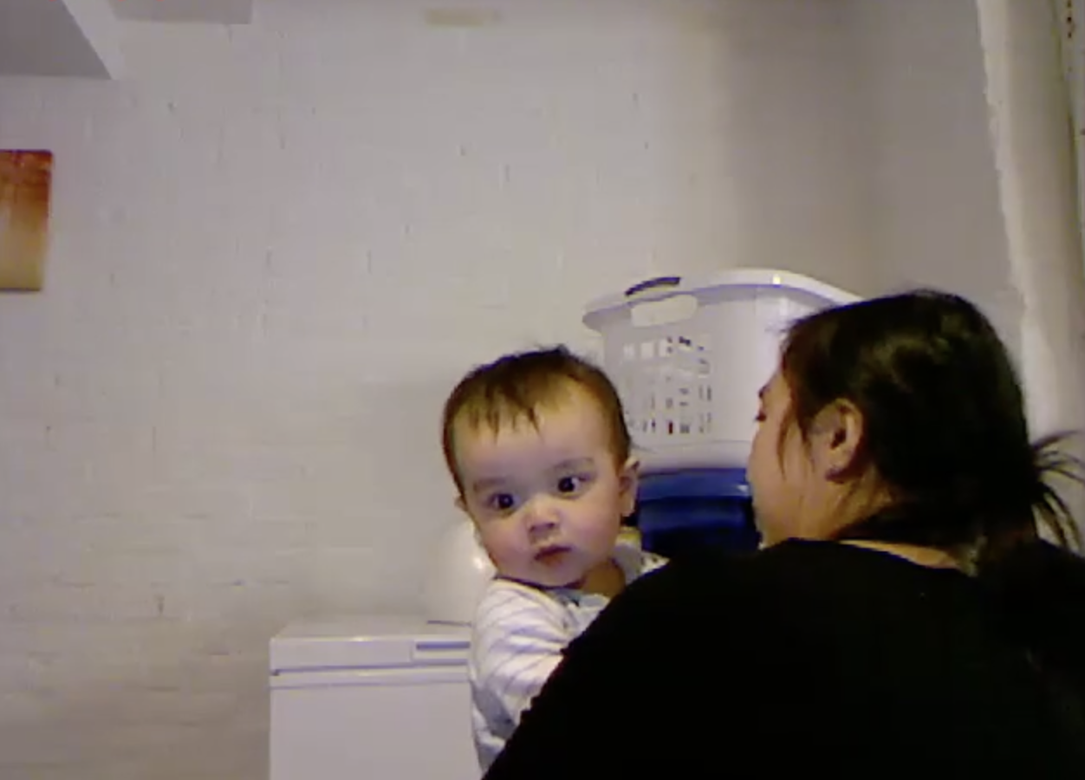
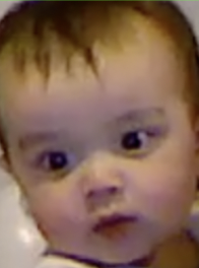
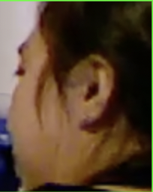
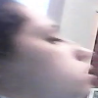
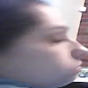
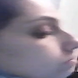
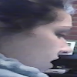
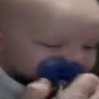
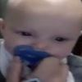
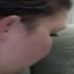
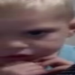
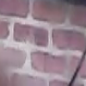
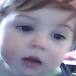
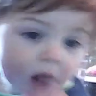
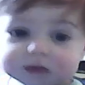
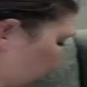

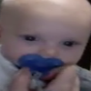
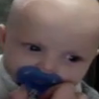
Face Extractor
0.5
0.8
Threshold = 0.7
Detector
0.9
0.4
Video Frame
Face Detection with Confidence Score
Extracted Image Patches
Example image patches from Lookit dataset:
Wrong
patch
Wrong
patch
Wrong
patch
Frame 1
Frame 2
Frame 3
Frame 4
Frame 1
Frame 2
Frame 3
Frame 4
Notes:
For the face extractor, we apply OpenCV’s pretrained face detection model, and filter the output patches by a threshold on the confidence score.
Here are some example outputs. Most of them are exactly faces, but there are still some errors.
iCatcher assumes the bottom line are infant faces, which can be wrong.

Slide 8
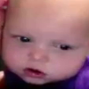
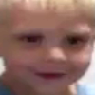



2. Infant Selector
Extracted face patches in certain frame
Manually curated dataset:
200 training images, 100 test images, half for each class
Is infant?
Classifier
Classifier | Accuracy
Lowest-face | 60.5%
VGG-11 | 92.5%
VGG-16 | 95.0%
ResNet-18 | 94.0%
ResNet-34 | 91.5%
Wide ResNet | 87.5%
Yes
Yes
Yes
No
Previous Frame
Current Frame
Nearest Patch
Selected
infant face
Notes:
Our infant selector first uses a deep model to classify each patch into infant or non-infant.
If multiple infants are detected, it takes the patch that is closest to the previous infant patch,
since the baby is unlikely to shift drastically between frames.
To train the classifier, we manually labeled three hundreds image patches, and tried different architectures and hyperparameters.
We use VGG-sixteen in downstream experiments since it performs the best.

Slide 9
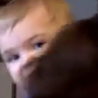
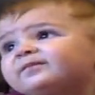
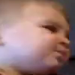
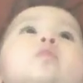

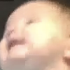
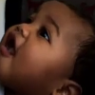
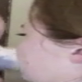
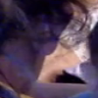
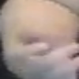
Infant Classifier: Failure Cases
Type I Error: undetected infants
By default, no-infant frames are assigned “away” label
Coincides with when infant is looking away
undetected infants
Type II Error: “fake” infants
Multiple infant faces per frame
Corrected by nearest patch
“fake” infants
Notes:
Here are the ten failure cases of the best classifier.
Seven of them are undetected infants and they are assigned ``away’’ label by default.
This is fine because most of their true labels are exactly “away”.
There are three false positives, but they can be corrected by choosing the nearest patch mentioned before.
Actually, all three errors here are indeed corrected in our experiment.

Slide 10
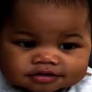
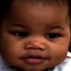
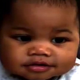
3. Gaze Estimator
5 interleaved frames
Face
Encoder
Face
Encoder
Predictor
Predictor
Feature
Encoder
Feature
Encoder
H, w, S, x, y
H, w, S, x, y
Single-frame gaze estimator
Multi-frame gaze estimator
Face Encoder: ResNet-18
Feature Encoder: 2 fully-connected layers
Predictor: 3 fully-connected layers
Notes:
We tried two kinds of gaze estimators to predict the gaze direction, single-frame and multi-frame.
They concatenate the embedding of image patch with the encoded positional information as input to the predictor.

Slide 11
Gaze Direction Classification Accuracy
Full Lookit Dataset: Training set: 600,000 frames; Test set: 400,000 frames
 | Lowest-face | Ours
Single-frame | 82.14% | 83.58%
Single-frame + Positional Info. | 82.23% | 84.20%
Multi-frame | 84.25% | 85.61%
Multi-frames + Positional Info. | 84.65% | 85.95%
Multi-frame(E) | 86.23% | 88.11%
Multi-frame(E) + Positional Info. | 86.98% | 88.58%
<
<
<
<
<
<
<
<
<
<
<
<
E: Eliminating all the transition datapoints (gaze direction classes change within the datapoint).
Notes:
We trained the estimator under different infant face selectors and input features on the Lookit dataset.
We also trained it after eliminating all the transition datapoints, since the transitions between classes can be vague even to humans.
The results show that the models with our infant selector deliver higher accuracies
and adding positional information does improve the performance in all six settings.
So both of our modifications to the baseline are effective.

Slide 12
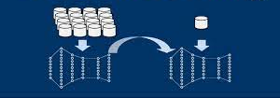
Limitation and Future Works
Transition datapoints
Face extraction suffer from occlusions
Very small dataset for the infant classifier
Transfer Learning
Developing a framework without face extraction
e.g. using eye extraction
Calibration step:
Ask the infants to look at something that moves around the screen boundary.
Notes:
One weakness of our implementation is two hundreds images is too few to train the infant classifier from scratch, so we can try transfer learning to enhance it.
Another limitation is face extraction may fail when the infant’s face is largely occluded and only eyes are visible. One alternative is to use eye extraction.
Finally, it may be helpful to add a calibration step about the boundary of the screen, which can help to distinguish the gaze direction between left or right and away.

Slide 13
Thank you!
Questions?
Notes:
That’s all. Thank you.

